Slide 1
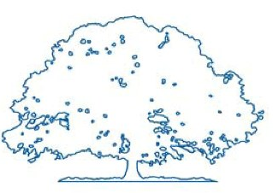
Raleigh Public Record: Summary Page Design
Team Members: Matt Baker, Kyrstin Hill, Matt Love, Steven Mucci, Joseph Wiggins, Lara Stocks

Slide 2
About Raleigh Public Record
Online newspaper
Nonprofit that focuses on local politics
Provides voter’s guide for public each election
Candidate Profiles
Articles

Slide 3
Problem
Unfriendly user interface for voter’s guide
Complex layout that requires a large amount of navigating and reading time
New voter’s guide developed for every election

Slide 4
Solution
Design simple summary page for election coverage
Minimize amount of reading with condensed content
Create minimalist stylesheet to ease development of voter guide
Quick utility tool for authoring candidate profiles

Slide 5
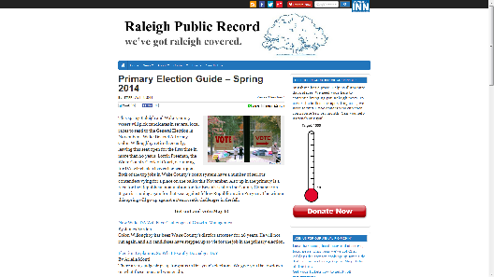
Demo
Current site
Proposed site

Slide 6

Thank you.
Any questions?

